Slide 1

IoT-based Platform
Air Quality (PM2.5) Monitoring System
Big Data Tool with Apache Kylin
Project Members:
Suyogya Ratna Tamrakar (st121334)
Younten Tshering (st121775)
Smrity Baral (st121662)
Shubhangini Gontia (st121473)
Submitted to :
Dr. Apichon Witayangkurn
AT70.19 Software Development and Quality Improvement

Slide 2
Outlines
Overview on Big Data
Overview on Hadoop
Apache Kylin
Updated System Architecture
Process of getting started with Kylin
Update on the project
Subsystem decomposition
Access Matrix
Future Work

Slide 3



Overview on Big Data
Now, before moving on to Apache Kylin, let us start the with Big Data, that led to the development of Hadoop and then to Apache Kylin.

Slide 4
Big Data is a problem statement
1. The first problem is storing the huge amount of data.
Storing huge data in a traditional system is not possible. The reason is obvious, the storage will be limited to one system and the data is increasing at a tremendous rate.
2. The second problem is storing heterogeneous data.
The data is not only huge, but it is also present in various formats i.e. unstructured, semi-structured and structured. So, we need to make sure that we have a system to store different types of data that is generated from various sources.
3. Finally, the third problem, which is the processing speed.
Now the time taken to process this huge amount of data is quite high as the data to be processed is too large.

Slide 5
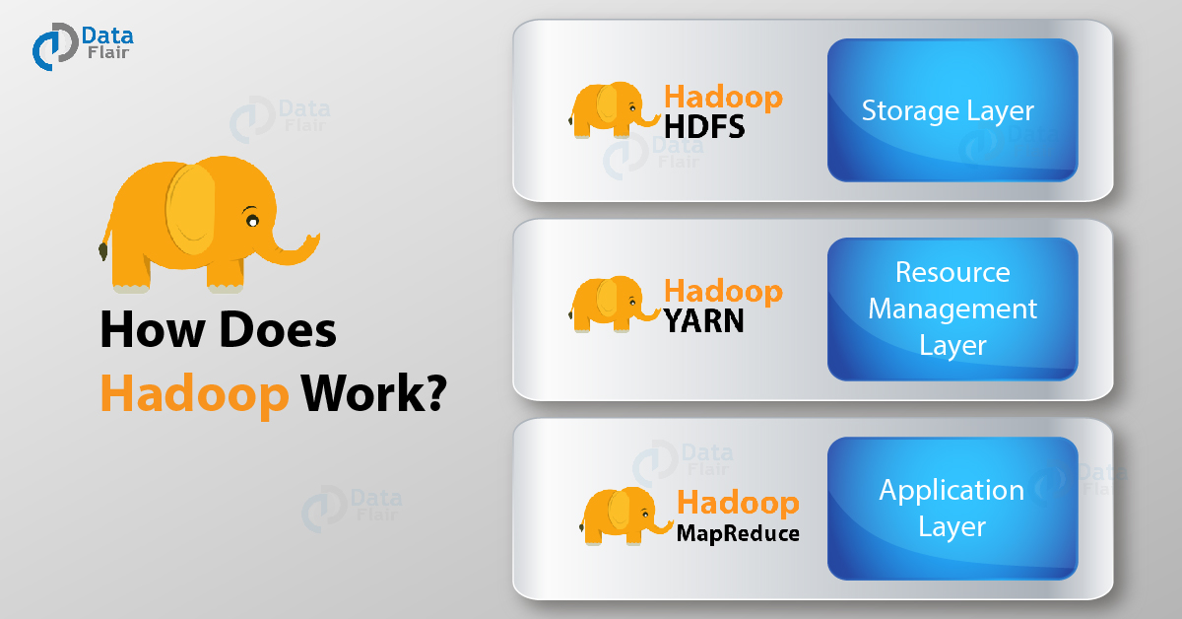
Overview on Hadoop
Notes:
To solve the storage issue and processing issue
— HDFS(Hadoop Distributed File System) and YARN(Yet Another Resource Negotiator).

Slide 6
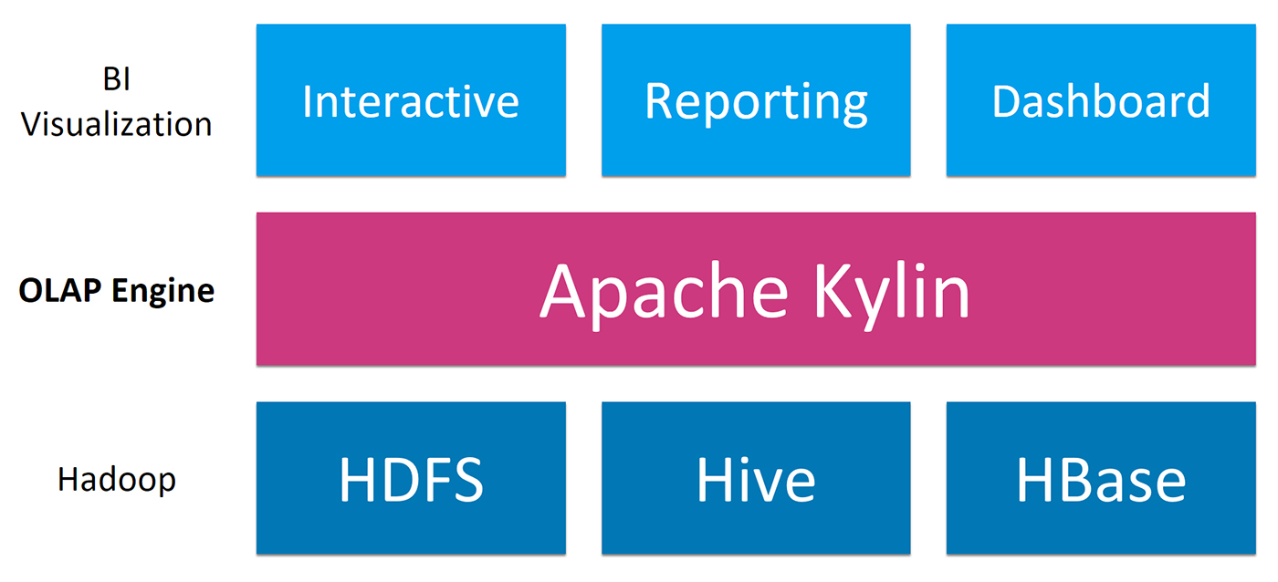
Hadoop Eco-system
The ecosystem around Hadoop is rapidly developing and adding on tools for various data needs. No single tool can provide both and hence we would have to go with a combination of tools.
The solution could be a combination of one Interactive Querying tool and one OLAP (online Analytical Processing) tool on Hadoop.

Slide 7
Apache Kylin
OLAP on Hadoop – Apache Kylin
Kylin is an open source Distributed Analytical Engine that provides SQL interface and multidimensional analysis (OLAP) on Hadoop supporting extremely large datasets. Apache kylin pre-calculates OLAP cubes and store the cubes into a reliable and scalable datastore (HBase).

Slide 8
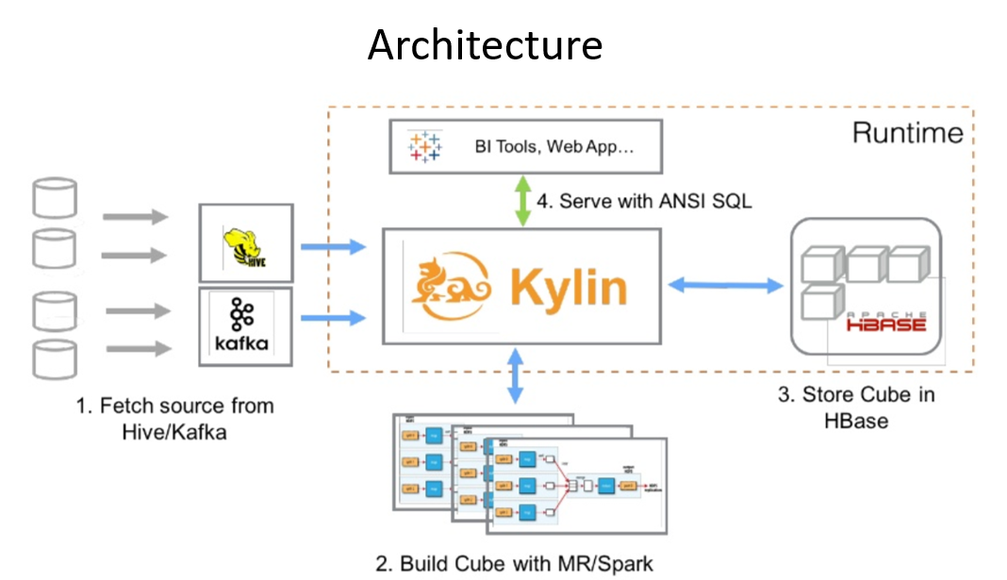
Apache Kylin: How it works?
Below are the steps on how Kylin fetches the data and saves the results:
First, sync the input source table. In most of the cases, it reads data from Hive.
Next it runs map reduce / spark jobs (based on the engine you select) to pre-calculate and generate each level of cuboids with all possible combinations of dimensions and calculate all the metrics at different levels.
Finally, it stores cube data(aggregated result) in HBase where the dimensions are rowkeys and measures are column family.
After aggregated data is ready, we can integrate with popular BI tools, such Tableau or Superset or connect with JDBC from our code. One more option is Kylin also provides the simple UI for quickly visit data.

Slide 9
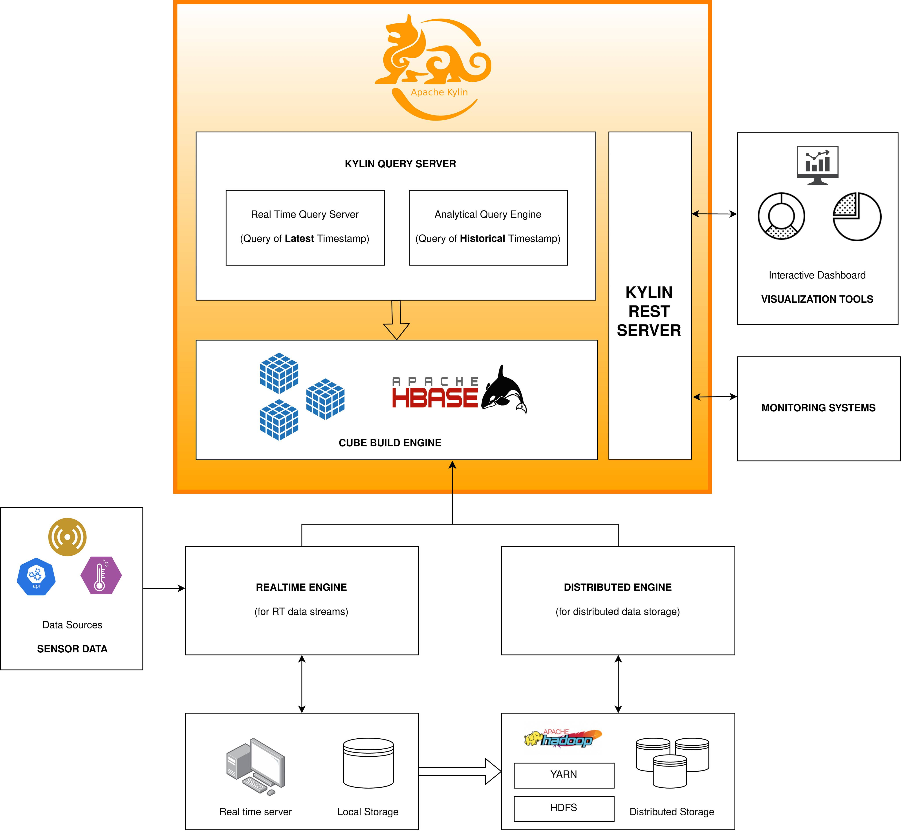
Updated System Architecture

Slide 10
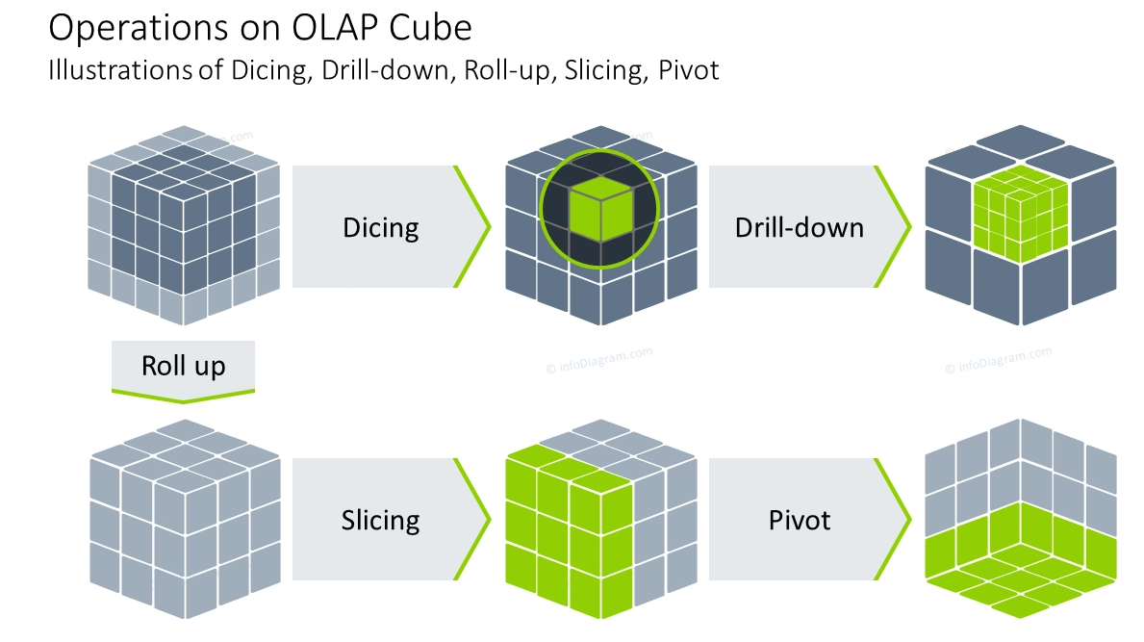

Slide 11
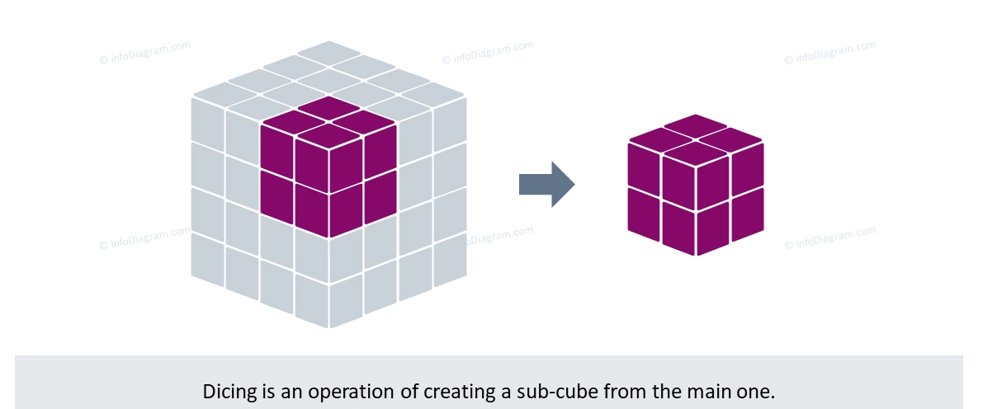

Slide 12
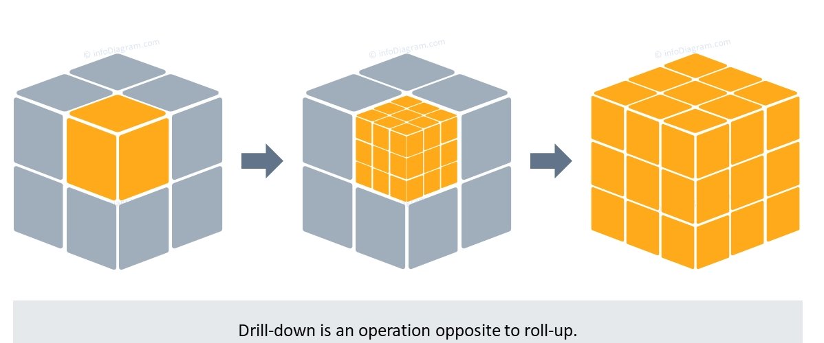

Slide 13
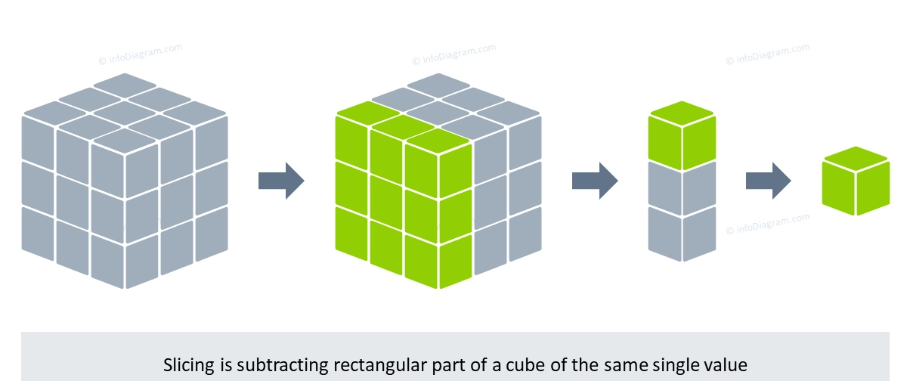

Slide 14
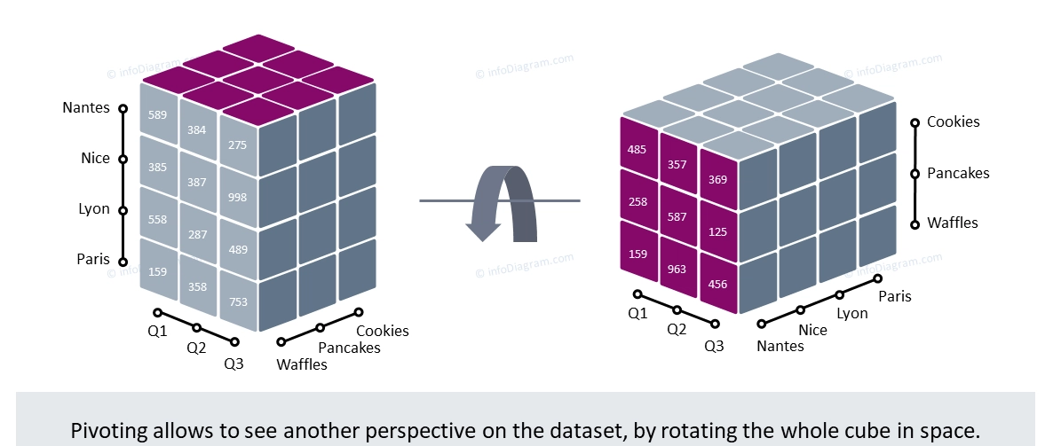

Slide 15
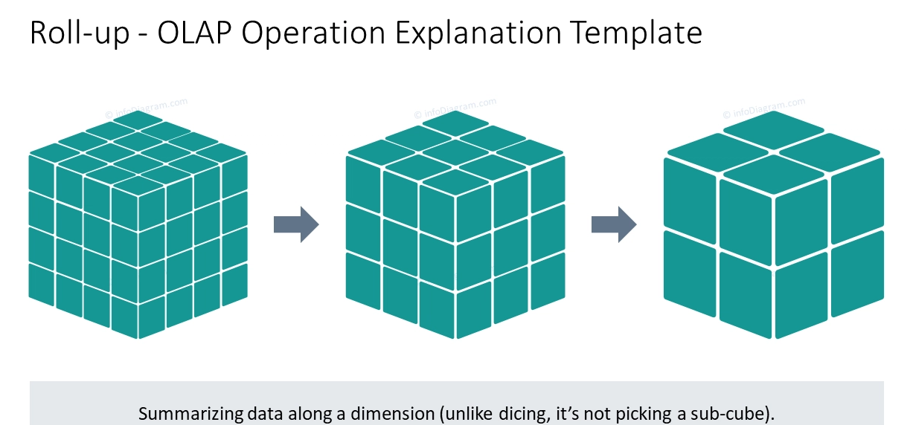

Slide 17
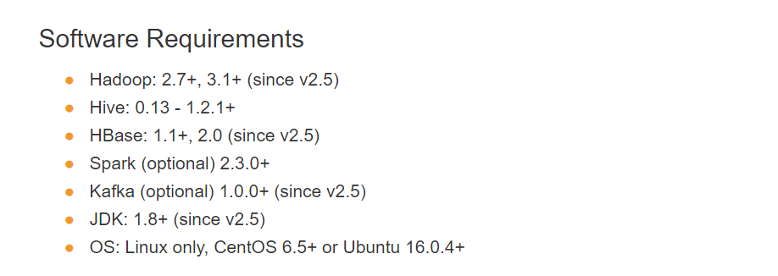
Process of getting started with Kylin
Kylin Installation:

Slide 18
Hadoop
Hadoop is an open-source software framework for storing data and running applications on clusters of commodity hardware.
Hive
Apache Hive is an open source data warehouse software for reading, writing and managing large data set files that are stored directly in either the Apache Hadoop Distributed File System (HDFS)
HBase
Apache HBase is used to have random, real-time read/write access to Big Data. It hosts very large tables on top of clusters of commodity hardware
Kafka
Kafka is used for real-time streams of data, to collect big data, or to do real time analysis (or both).
JDK and Linux

Slide 19
Hardware Requirement
The minimum configuration of a server running Kylin is 4 core CPU, 16 GB RAM and 100 GB disk. For high-load scenarios, a 24-core CPU, 64 GB RAM or higher is recommended.
Kylin relies on Hadoop clusters to handle large data sets. You need to prepare a Hadoop cluster with HDFS, YARN, MapReduce, Hive, HBase, Zookeeper and other services for Kylin to run.
Kylin can be launched on any node in a Hadoop cluster.

Slide 20
Download Kylin from below link and
https://kylin.apache.org/download/
Once installed, start kylin by following command
$KYLIN_HOME/bin/kylin.sh start
You can open the GUI from
http://<hostname>:7070/kylin

Slide 21
Kylin Image from Docker hub
Docker is a set of platform as a service products that use OS-level virtualization to deliver software in packages called containers. Containers are isolated from one another and bundle their own software, libraries and configuration files
docker pull apachekylin/apache-kylin-standalone:3.1.0

Slide 22
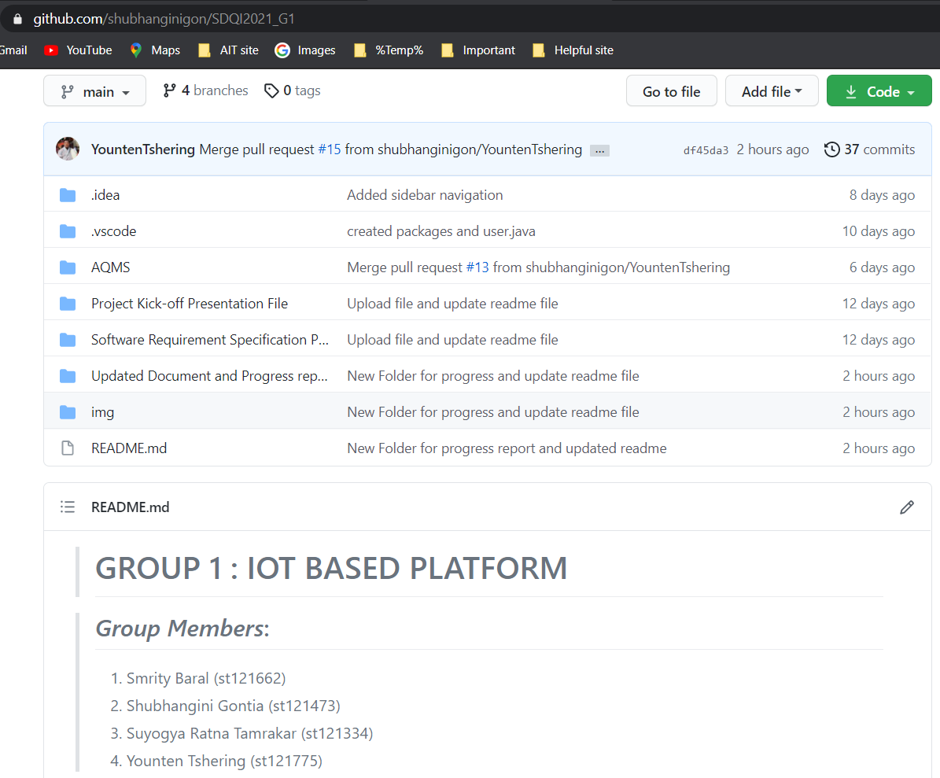
Update on the project
https://github.com/shubhanginigon/SDQI2021_G1

Slide 23
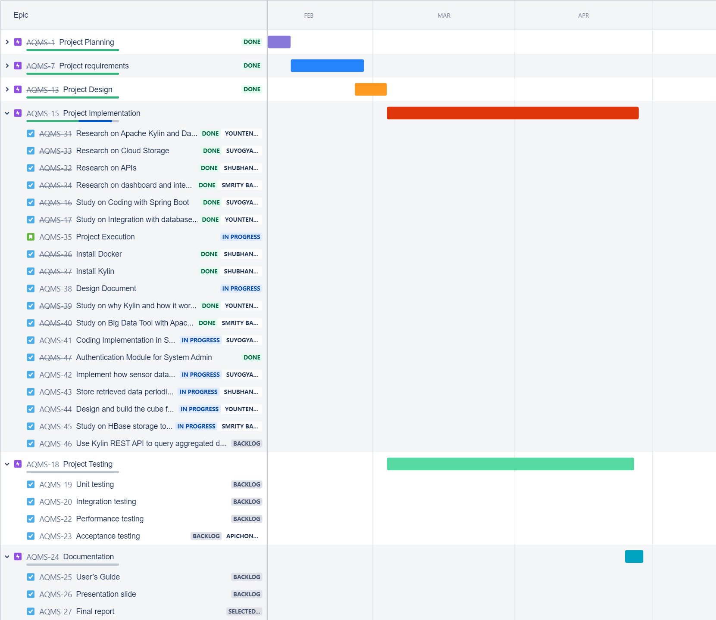
Schedule
https://sqdi2021g1.atlassian.net/jira/software/c/projects/AQMS/boards/4/roadmap

Slide 24
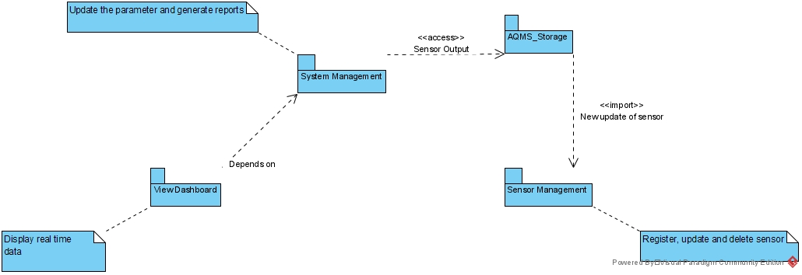
Subsystem decomposition

Slide 25
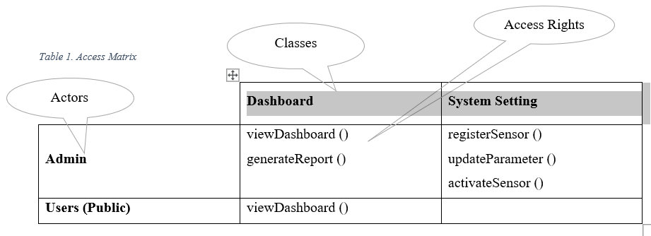
Access Matrix

Slide 26
Future Work
Integration with Hadoop
Some part of Design Document
Project Testing
Final Project Documentation

Slide 27
References
Apache Kylin. ( 2015). Bring OLAP back to big data! Retrieved from Apache Kylin | Analytical Data Warehouse for Big Data
Fann,N.,& Risley,D. (2011,January 5). The public health context for PM2.5 and ozone air quality trends. Air Qual Atmos Health 6, 1–11 (2013). https://doi.org/10.1007/s11869-010-0125-0
Geetha,S.M.N. (2021, March 19). Hadoop for Analyst-Apache Druid, Apache Kylin and Interactive query tools. Retrieved from https://www.saigeetha.in/post/hadoop-for-analysts-apache-druid-apache-kylin-and-interactive-query-tools?fbclid=IwAR0RRXXxKmv8onswnS-g5mV5Hh_L5R9zOSWly6YO8d4kb6oYYW4rrjF5wlo
Gupta,A.k., & Johari,R. (2019). IOT based electrical device surveillance and control system. International Conference on Internet of Things: Smart Innovation and Usages (IoT-SIU), https://doi.org/10.1109/IoT-SIU.2019.8777342
Nethu, M.V. (2018, September 25). OLAP on Hadoop-Apache Kylin. Retrieved from https://medium.com/@mvneethu90/olap-in-hadoop-apache-kylin-bf0377d8b44f
Sinha, S. (2016, October 28). Hadoop ecosystem- Get to know the Hadoop tools for crunching Big Data. edureka. Retrieved from https://medium.com/edureka/hadoop-ecosystem-2a5fb6740177
Sinha,S. (2014, October 9). Hadoop tutorial- A comprehensive guide to Hadoop. edureka. Retrieved from https://medium.com/edureka/hadoop-tutorial-24c48fbf62f6

Slide 28
Questions and
Feedback

